Slide 1

Shield Insurance
Business insights
-Albert Shaju

Slide 2
Background Information about the shield insurance
Shield insurance is operating in 5 different cities.
Chennai
Delhi
Hyderabad
Indore
Mumbai

Slide 3
Sales Modes
1. Offline Sales Mode
Agent
Direct
2. Online Sales Mode
App
Website

Slide 4
Age group
The insurance is tailored according to the age groups.
18-24
25-30
31-40
41-50
51-65
65+

Slide 5
Dashboard

Slide 6
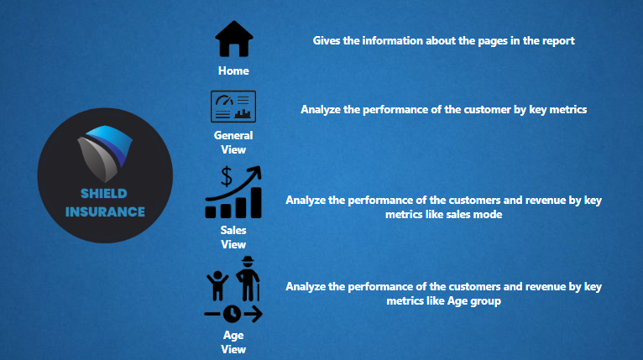

Slide 7
Home
The dashboard's "Home" page provides details about the report's pages.
General View
"General view" analyze the performance of the customer by key metrics.
Sales View
"Sales view" analyze the performance of the customer and revenue by key metrics like sales mode.
Age View
"Age view" analyze the performance of the customer and revenue by key metrics like Age group.

Slide 8
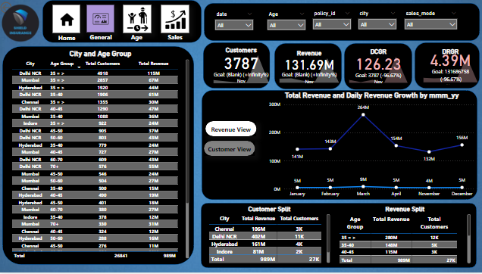

Slide 9
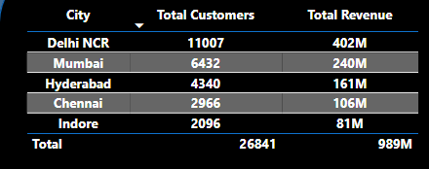


General view
KPI’s
Total revenue - 989M
Total customer - 27K
Daily customer growth - 126.23
Daily revenue growth - 4.39M

Slide 10
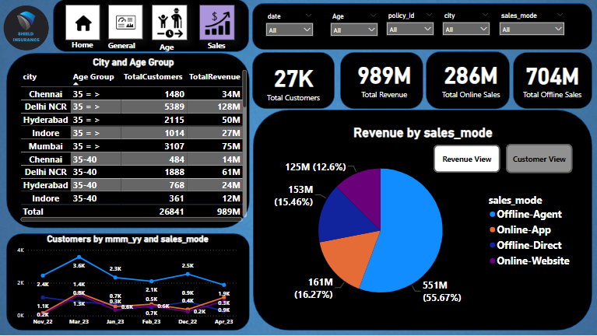

Slide 11
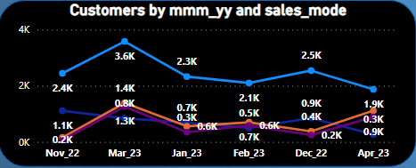
Sales view
The most number of Customers acquired in March 2023.

Slide 12
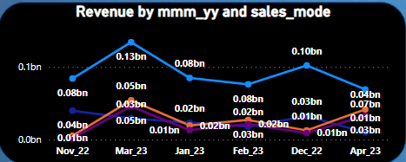
Sales view
The highest revenue generated month is March 2023.

Slide 13
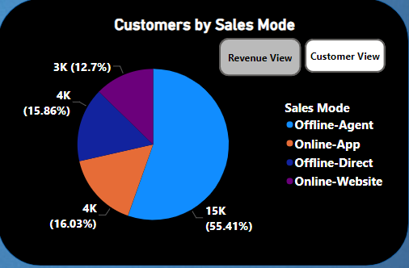
Sales view
Customer acquisition by Sales Mode.
The Highest number of Customers were acquired by Offline agent.

Slide 14
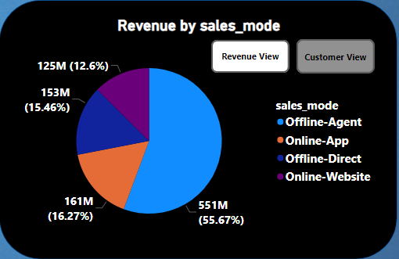
Sales view
Revenue generated by Sales Mode.
The Highest contribution of Revenue generation is by Offline agent.

Slide 15
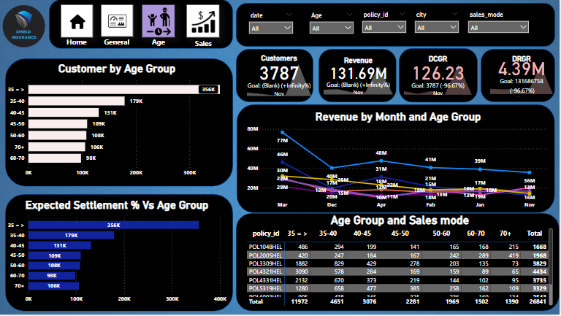

Slide 16
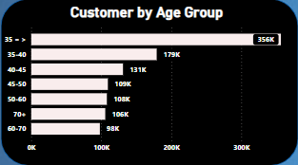
Age View
Customers divided in the Age Groups.
The age group of 35 >= have the maximum number of customers.

Slide 17
Summary
March stands out as the month generating the highest revenue.
March witnessed the most significant customer acquisition.
Delhi NCR leads in both customer numbers and revenue.
The age range of 31-40 dominates in both revenue and customer count.
Offline Agent mode proves to be the most successful for revenue and customer acquisition.
The age group of 65 and above anticipates the highest settlement.
The top-selling policy, POL4321HL, comes with a Rs.5000 Base Premium.

Slide 18
-
Thank you
-

